Slide 1

Pricing and risk analysis of reverse mortgage loans
原文作者: Wenqiang Shao, June 2014
0253924 張錦炘

Slide 2
OUTLINE
PRICING FRAMEWORK
HOUSE PRICE MODEL

Slide 3
Pricing Framework

Slide 4
Pricing Framework
We model a reverse mortgage loan with variable interest rates and a single payment at issuance.
The outstanding loan amount accumulates until the borrower dies or permanently leaves the house due to non-mortality reasons.
We focus on single female borrowers who are the most common reverse mortgage borrowers in the United States. In Australia, the majority of reverse mortgage borrowers are couples, and single females are the second most common borrowers.

Slide 5
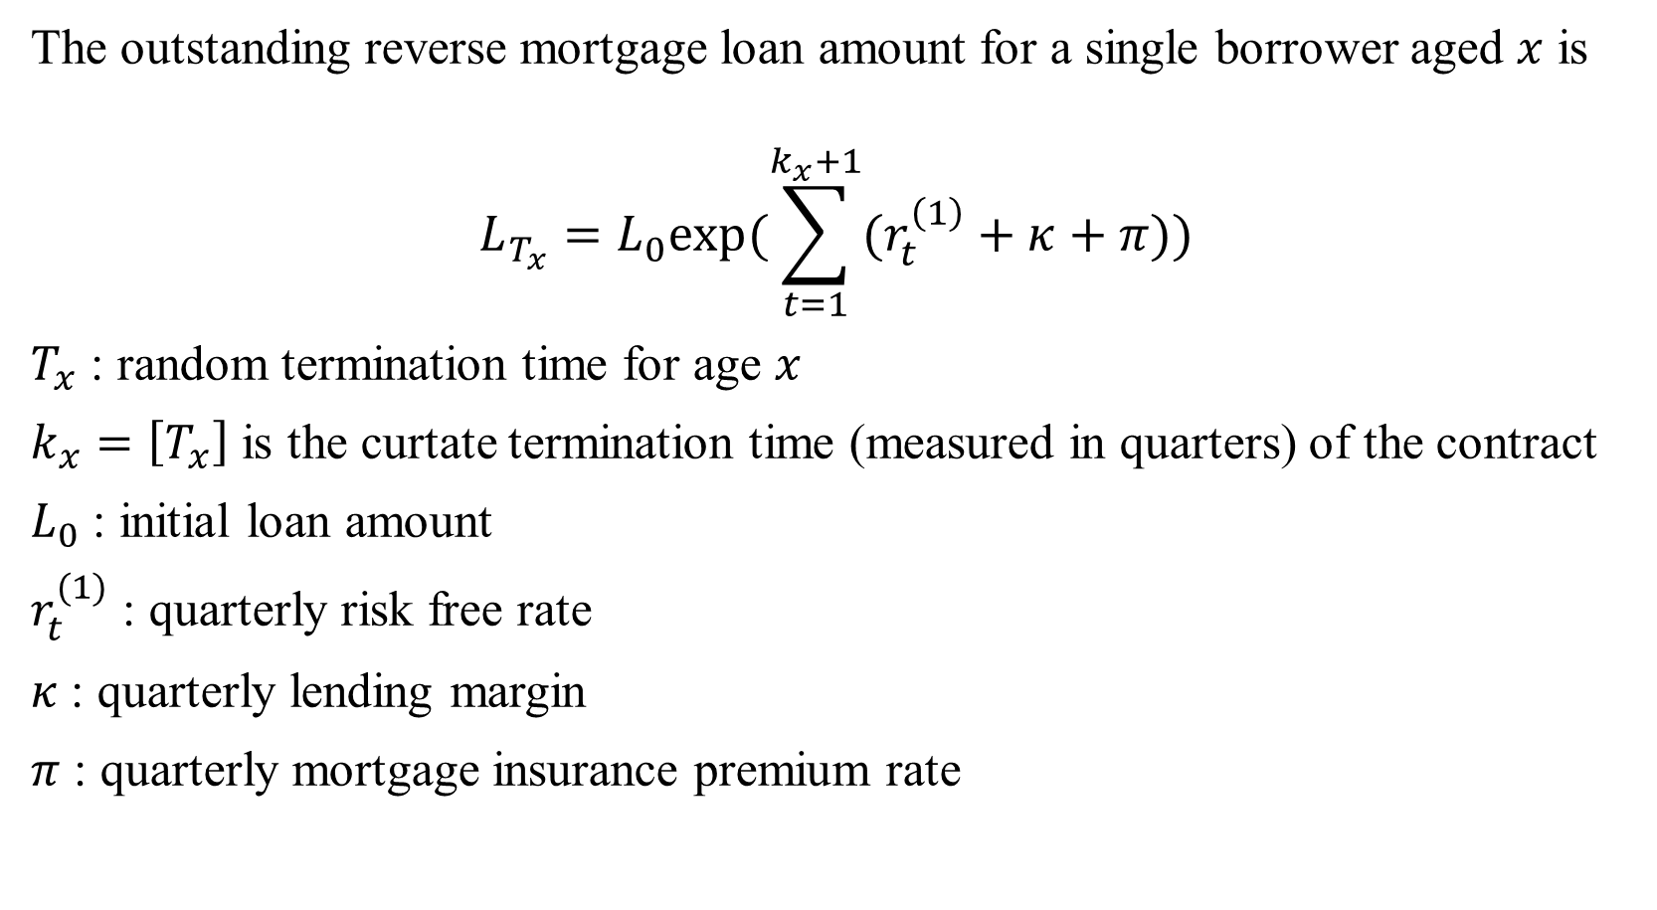
The outstanding reverse mortgage loan amount for a single borrower aged $x$ is
$$L_{T_{x}}=L_{0}exp⁡(\sum_{t=1}^{k_{x}+1}{(r_{t}^{\left(1\right)}+κ+π)})$$
$T_{x}$ : random termination time for age $x$
$k_{x}=\left[T_{x}\right]$ is the curtate termination time (measured in quarters) of the contract
$L_{0}$ : initial loan amount
$r_{t}^{(1)}$ : quarterly risk free rate
$κ$ : quarterly lending margin
$π$ : quarterly mortgage insurance premium rate

Slide 6
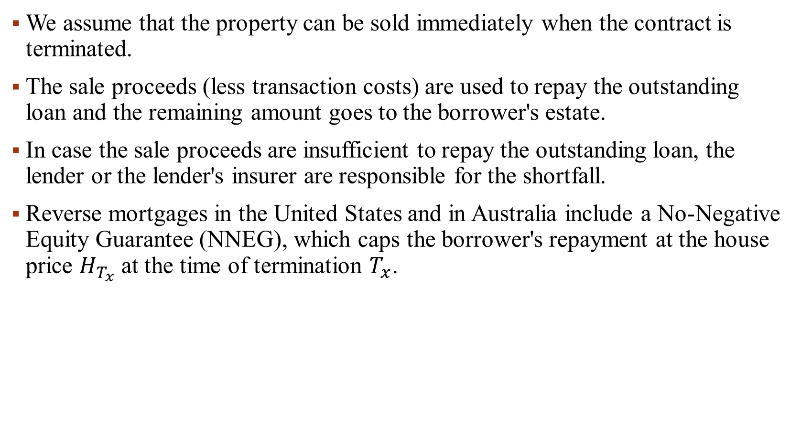
We assume that the property can be sold immediately when the contract is terminated.
The sale proceeds (less transaction costs) are used to repay the outstanding loan and the remaining amount goes to the borrower's estate.
In case the sale proceeds are insufficient to repay the outstanding loan, the lender or the lender's insurer are responsible for the shortfall.
Reverse mortgages in the United States and in Australia include a No-Negative Equity Guarantee (NNEG), which caps the borrower's repayment at the house price $H_{T_{x}}$ at the time of termination $T_{x}$.

Slide 7
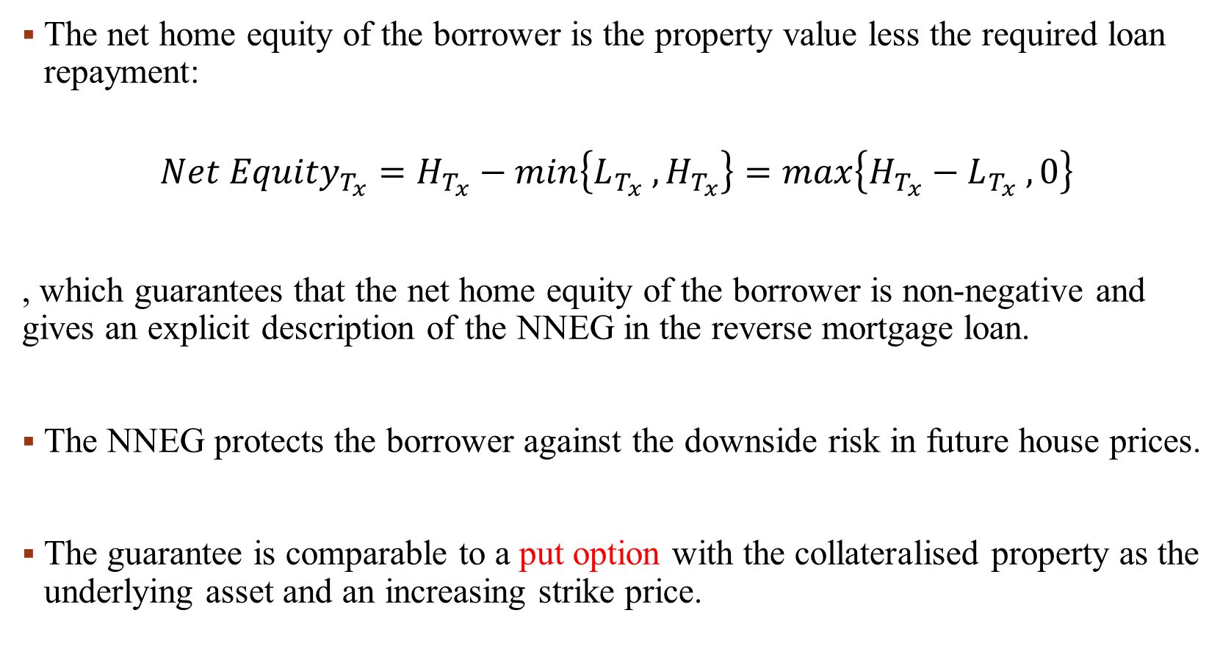
The net home equity of the borrower is the property value less the required loan repayment:
$${Net Equity}_{T_{x}}=H_{T_{x}}−min\left\{L_{T_{x}} , H_{T_{x}}\right\}=max⁡\left\{H_{T_{x}}−L_{T_{x}} , 0\right\}$$
, which guarantees that the net home equity of the borrower is non-negative and gives an explicit description of the NNEG in the reverse mortgage loan.
The NNEG protects the borrower against the downside risk in future house prices.
The guarantee is comparable to a put option with the collateralised property as the underlying asset and an increasing strike price.

Slide 8
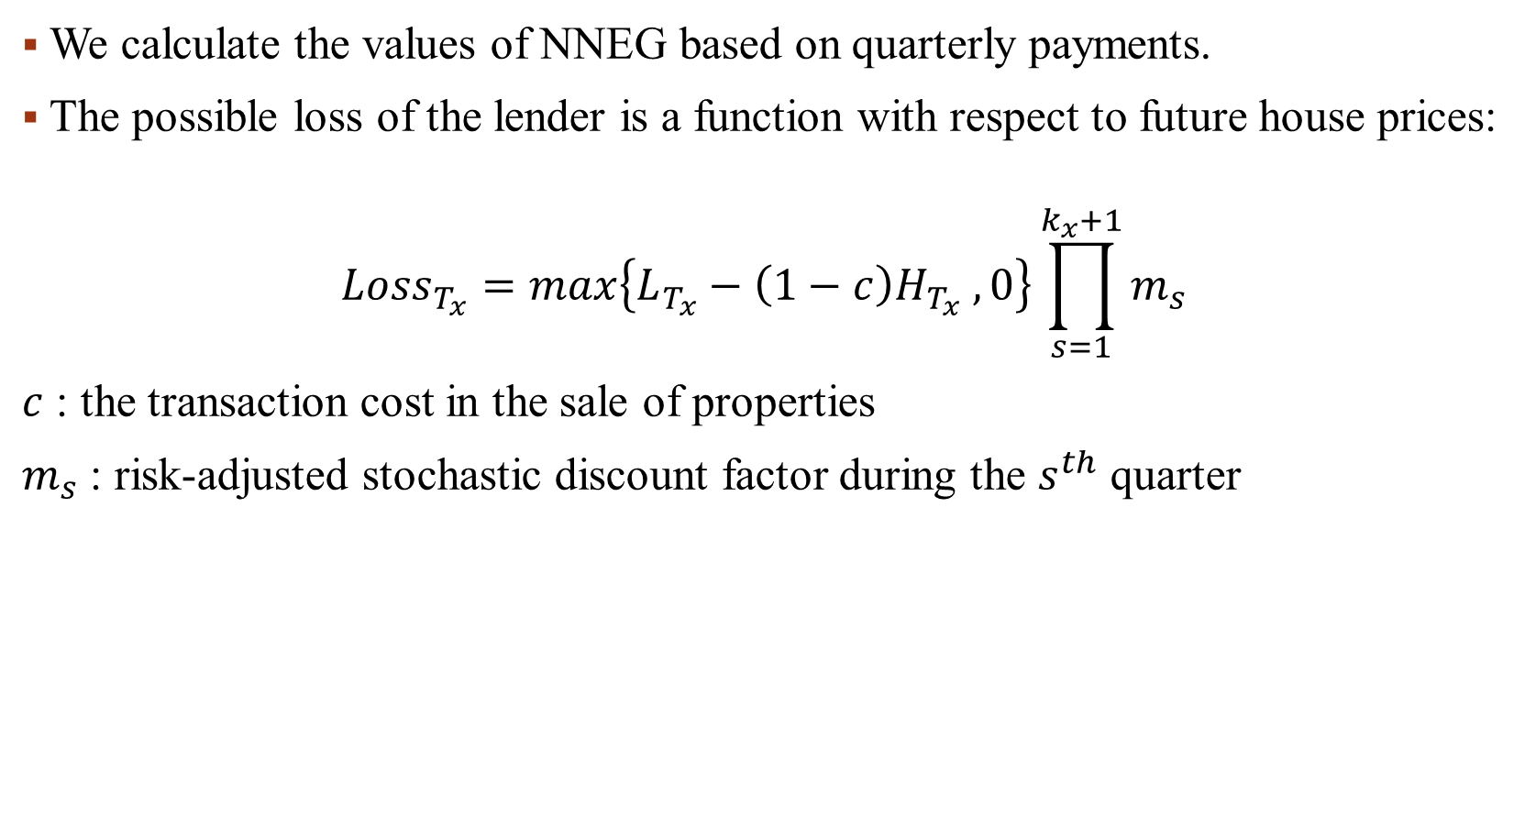
We calculate the values of NNEG based on quarterly payments.
The possible loss of the lender is a function with respect to future house prices:
$${Loss}_{T_{x}}=max\left\{L_{T_{x}}−\left(1−c\right)H_{T_{x}} , 0\right\}\prod_{s=1}^{k_{x}+1}{m_{s}}$$
$c$ : the transaction cost in the sale of properties
$m_{s}$ : risk-adjusted stochastic discount factor during the $s^{th}$ quarter

Slide 9
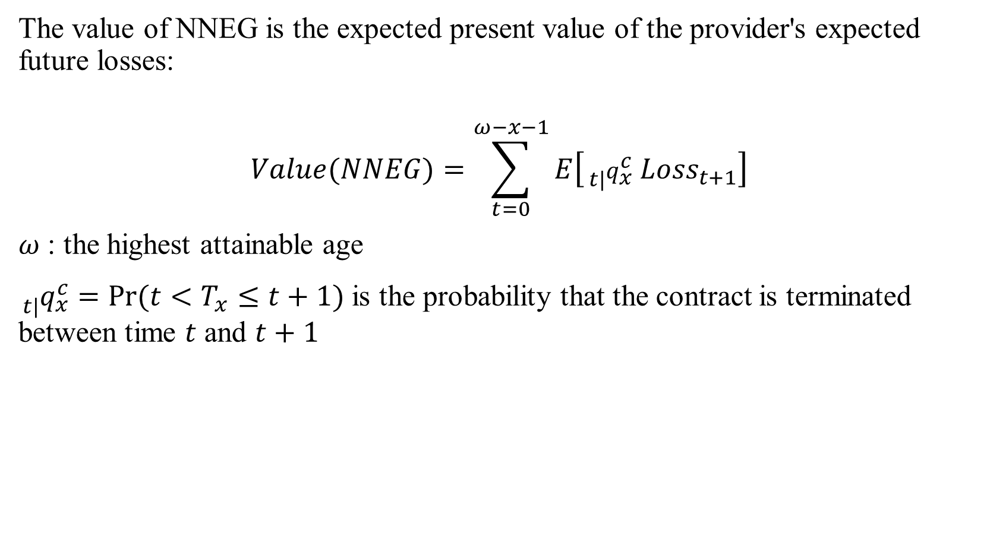
The value of NNEG is the expected present value of the provider's expected future losses:
$$Value(NNEG)=\sum_{t=0}^{ω−x−1}{E\left[{{}_{t|}^{}q}_{x}^{c} {Loss}_{t+1}\right]}$$
$ω$ : the highest attainable age
${{}_{t|}^{}q}_{x}^{c}=Pr⁡(t<T_{x}≤t+1)$ is the probability that the contract is terminated between time $t$ and $t+1$

Slide 10
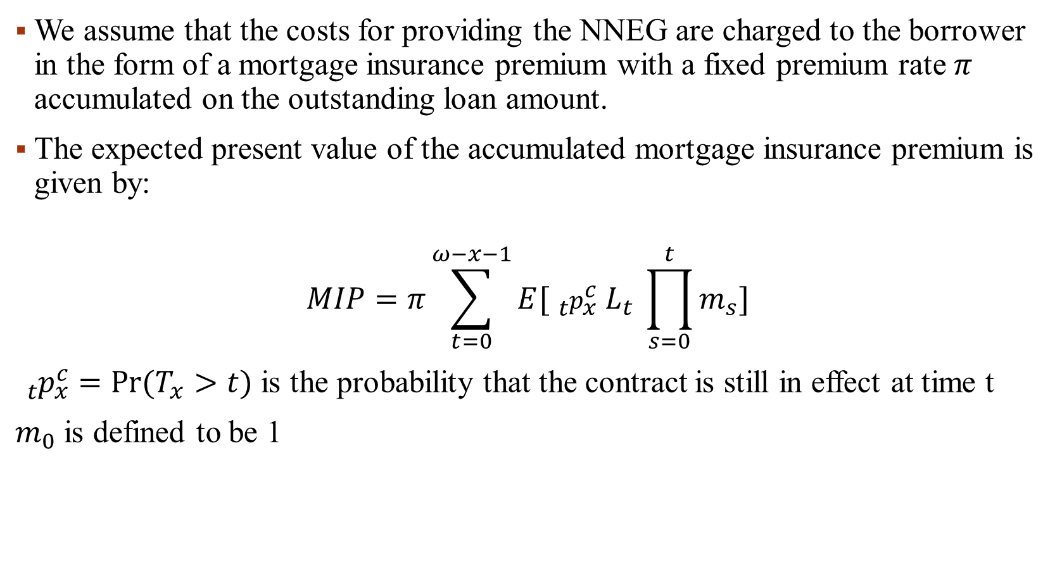
We assume that the costs for providing the NNEG are charged to the borrower in the form of a mortgage insurance premium with a fixed premium rate $π$ accumulated on the outstanding loan amount.
The expected present value of the accumulated mortgage insurance premium is given by:
$$MIP=π\sum_{t=0}^{ω−x−1}{E[{{}_{t}^{}p}_{x}^{c} L_{t} \prod_{s=0}^{t}{m_{s}}]}$$
${{}_{t}^{}p}_{x}^{c}=Pr⁡(T_{x}>t)$ is the probability that the contract is still in effect at time t
$m_{0}$ is defined to be 1

Slide 11
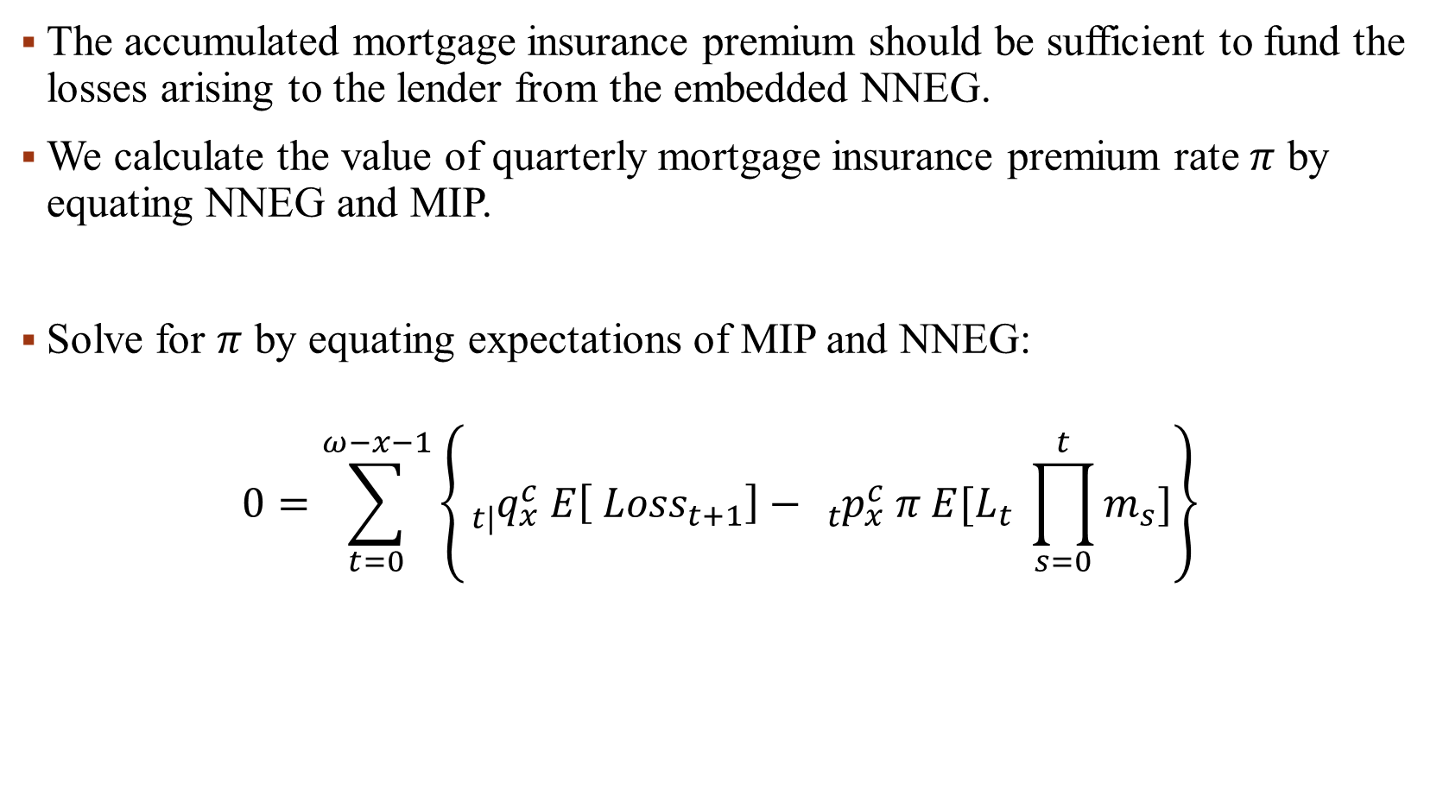
The accumulated mortgage insurance premium should be sufficient to fund the losses arising to the lender from the embedded NNEG.
We calculate the value of quarterly mortgage insurance premium rate $π$ by equating NNEG and MIP.
Solve for $π$ by equating expectations of MIP and NNEG:
$$0=\sum_{t=0}^{ω−x−1}{\left\{{{}_{t|}^{}q}_{x}^{c} E\left[ {Loss}_{t+1}\right]−{{}_{t}^{}p}_{x}^{c} π E[L_{t} \prod_{s=0}^{t}{m_{s}}]\right\}}$$

Slide 12
House Price model

Slide 13
HOUSE PRICE MODEL
HEDONIC MODEL
REPEAT-SALES MODEL
HYBRID HOUSE PRICE MODEL

Slide 14
Hedonic Model
中文稱作特徵價格法和效用估價法，將房地產商品的價格分解，以顯現出其各項特徵的隱含價格，在保持房地產的特徵不變的情況下，將房地產價格變動中的特徵因素分解，從價格的總變動中逐項剔除特徵變動的影響，剩下的便是純粹由供求關係引起的價格變動。
該理論認為，一種多樣性商品具有多方面的不同特征或品質(如房地產商品的面積、樓層、朝向和是否有保全服務等特征)，商品價格則是所有這些特征的綜合反映和表現。當商品某一方面的特征改變時，商品的價格也會隨之改變。
容易取樣，可以得到大量價格資料；模型的經濟意義比較直觀；計算相對簡單。但同時，運用特征價格法編製價格指數也存在多重共線性等問題。

Slide 15
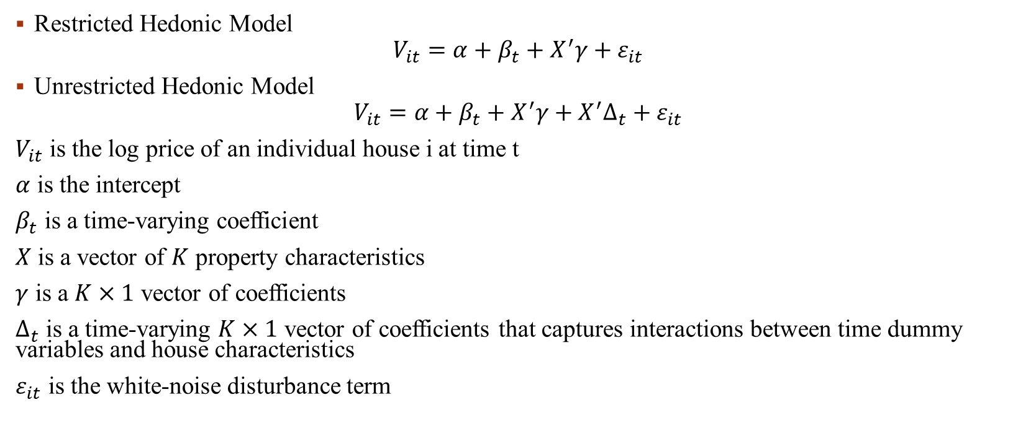
Hedonic Model
Restricted Hedonic Model
$$V_{it}=α+β_{t}+X^{′}γ+ε_{it}$$
Unrestricted Hedonic Model
$$V_{it}=α+β_{t}+X^{′}γ+X^{′}∆_{t}+ε_{it}$$
$V_{it}$ is the log price of an individual house i at time t
$α$ is the intercept
$β_{t}$ is a time-varying coefficient
$X$ is a vector of $K$ property characteristics
$γ$ is a $K×1$ vector of coefficients
$∆_{t}$ is a time-varying $K×1$ vector of coefficients that captures interactions between time dummy variables and house characteristics
$ε_{it}$ is the white-noise disturbance term

Slide 16
Repeat-sales model
中文稱作重覆售出模型，根據同一宗房地產在不同時期售出的價格來計算房地產價格指數。這樣，不同時期考察相同的房地產，在結構、材料、外部品質等方面都相同，免去了控制房地產品質的麻煩。
該方法經過實踐和專家的多次修正，在理論上已經相當完整，因此該方法被稱為國際上最先進的計算方法，能夠客觀、準確地反映出房地產市場的狀況。
該方法的優點是基於同一宗房地產的價格變化運行。在剔除標的物折舊的影響後，根據重覆交易法編製的指數可以滿足房地產價格“同質性”的需要。
缺點：有兩次重覆出售價格記錄的房地產數量有限，樣本容量相對較小，抽樣誤差較大；只利用重覆交易價格信息而偏廢一次性交易資料，難以保證資料的市場性；重覆交易函數模型中存在多重共線性的問題，即使用年限和兩次出售間隔是完全共線性的。因此，儘管重覆交易法的經濟意義比較直觀，計算也相對簡單，但在實際應用時仍有一些欠缺。

Slide 17
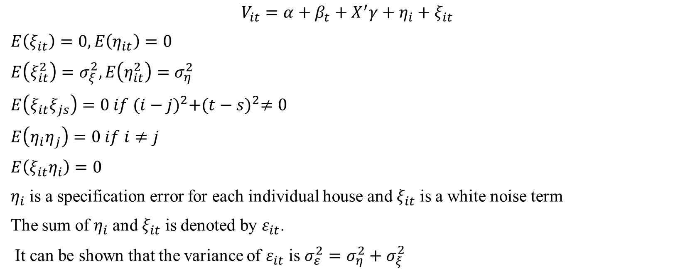
Repeat-sales model
$$V_{it}=α+β_{t}+X^{′}γ+η_{i}+ξ_{it}$$
$E\left(ξ_{it}\right)=0,E\left(η_{it}\right)=0$
$E\left(ξ_{it}^{2}\right)=σ_{ξ}^{2},E\left(η_{it}^{2}\right)=σ_{η}^{2}$
$E\left(ξ_{it}ξ_{js}\right)=0 if {(i−j)}^{2}+{(t−s)}^{2}≠0$
$E\left(η_{i}η_{j}\right)=0 if i≠j$
$E\left(ξ_{it}η_{i}\right)=0$
$η_{i}$ is a specification error for each individual house and $ξ_{it}$ is a white noise term
The sum of $η_{i}$ and $ξ_{it}$ is denoted by $ε_{it}$.
It can be shown that the variance of $ε_{it}$ is $σ_{ε}^{2}=σ_{η}^{2}+σ_{ξ}^{2}$

Slide 18
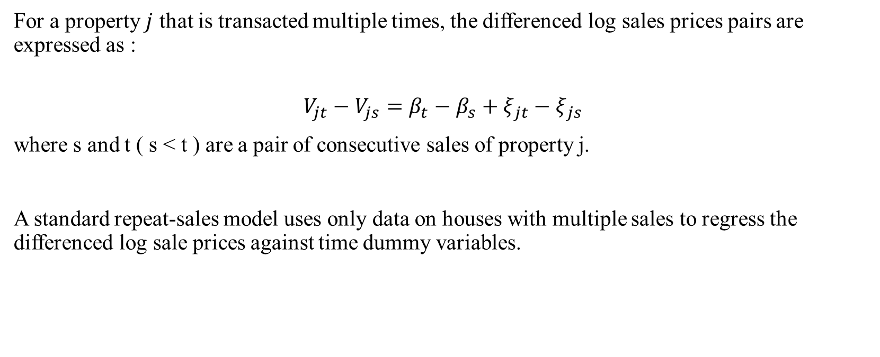
Repeat-sales model
For a property $j$ that is transacted multiple times, the differenced log sales prices pairs are expressed as :
$$V_{jt}−V_{js}=β_{t}−β_{s}+ξ_{jt}−ξ_{js}$$
where s and t ( s < t ) are a pair of consecutive sales of property j.
A standard repeat-sales model uses only data on houses with multiple sales to regress the differenced log sale prices against time dummy variables.

Slide 19
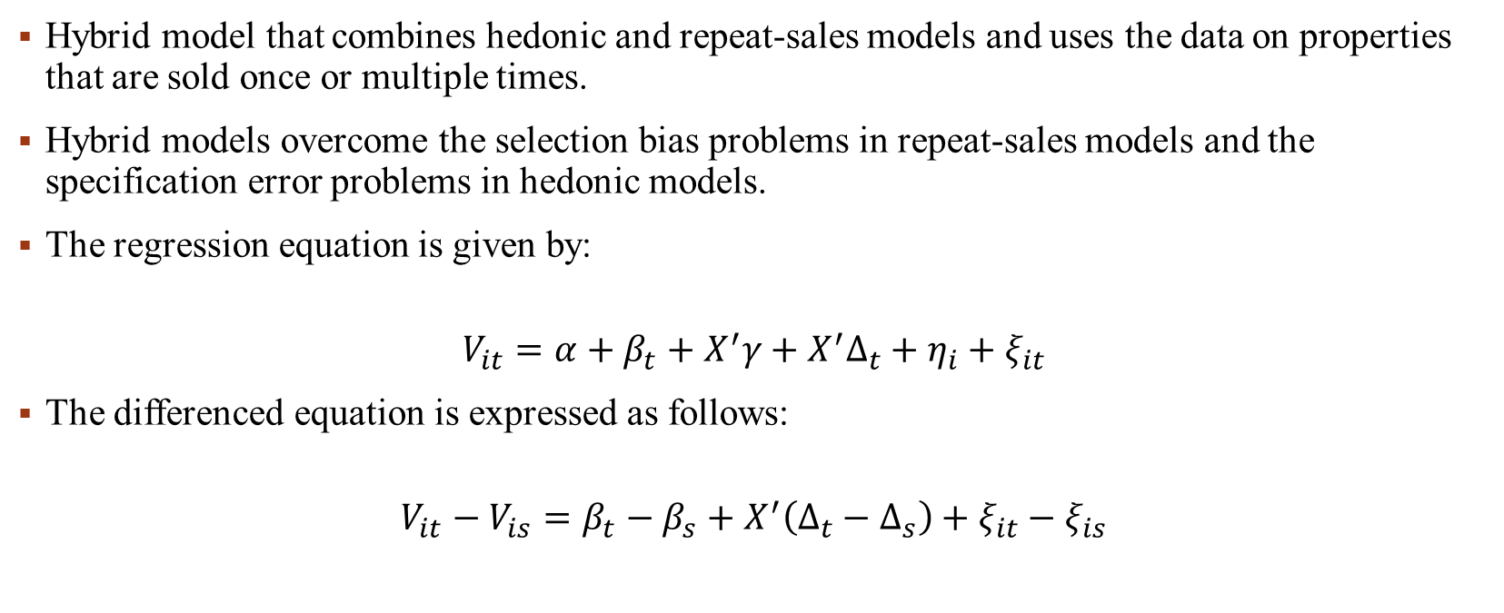
Hybrid house price model
Hybrid model that combines hedonic and repeat-sales models and uses the data on properties that are sold once or multiple times.
Hybrid models overcome the selection bias problems in repeat-sales models and the specification error problems in hedonic models.
The regression equation is given by:
$$V_{it}=α+β_{t}+X^{′}γ+X^{′}∆_{t}+η_{i}+ξ_{it}$$
The differenced equation is expressed as follows:
$$V_{it}−V_{is}=β_{t}−β_{s}+X^{′}\left(Δ_{t}−Δ_{s}\right)+ξ_{it}−ξ_{is}$$

Slide 20
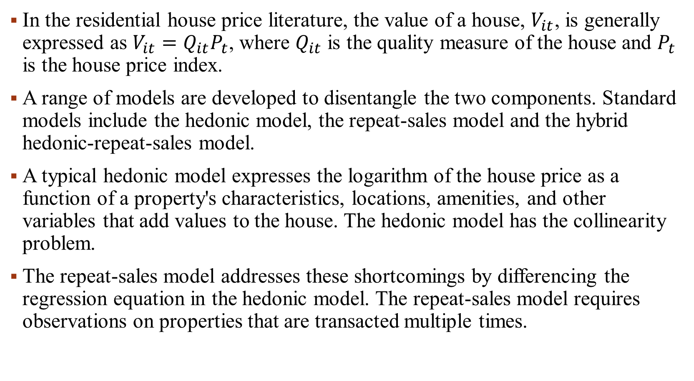
In the residential house price literature, the value of a house, $V_{it}$, is generally expressed as $V_{it}=Q_{it}P_{t}$, where $Q_{it}$ is the quality measure of the house and $P_{t}$ is the house price index.
A range of models are developed to disentangle the two components. Standard models include the hedonic model, the repeat-sales model and the hybrid hedonic-repeat-sales model.
A typical hedonic model expresses the logarithm of the house price as a function of a property's characteristics, locations, amenities, and other variables that add values to the house. The hedonic model has the collinearity problem.
The repeat-sales model addresses these shortcomings by differencing the regression equation in the hedonic model. The repeat-sales model requires observations on properties that are transacted multiple times.

Slide 21
Rest of this chapter
TERMINATION OF REVERSE MORTGAGES
RESULTS AND ANALYSIS

Slide 22
THANK you for your attention

